Slide 1


Analysis and training for the open-source KFALL DATASET
陈庭宇 230995210
刘泫含 230995215

Slide 2
Data analysis and preprocessing
01

Slide 3
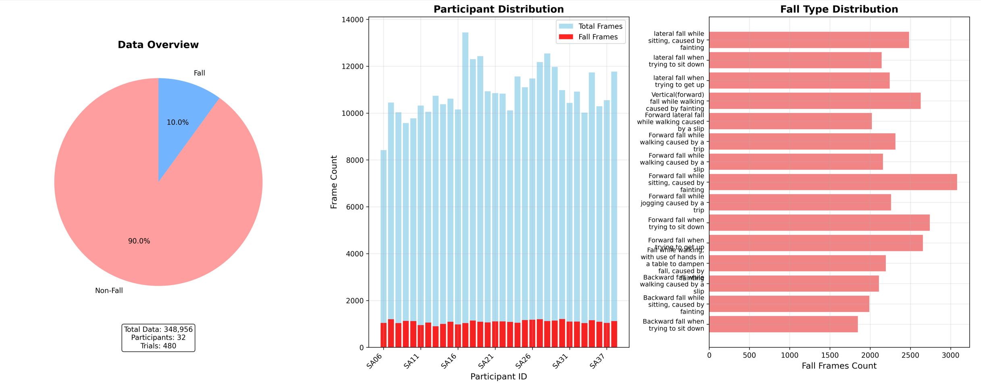
Data integration and visual analysis

Slide 4
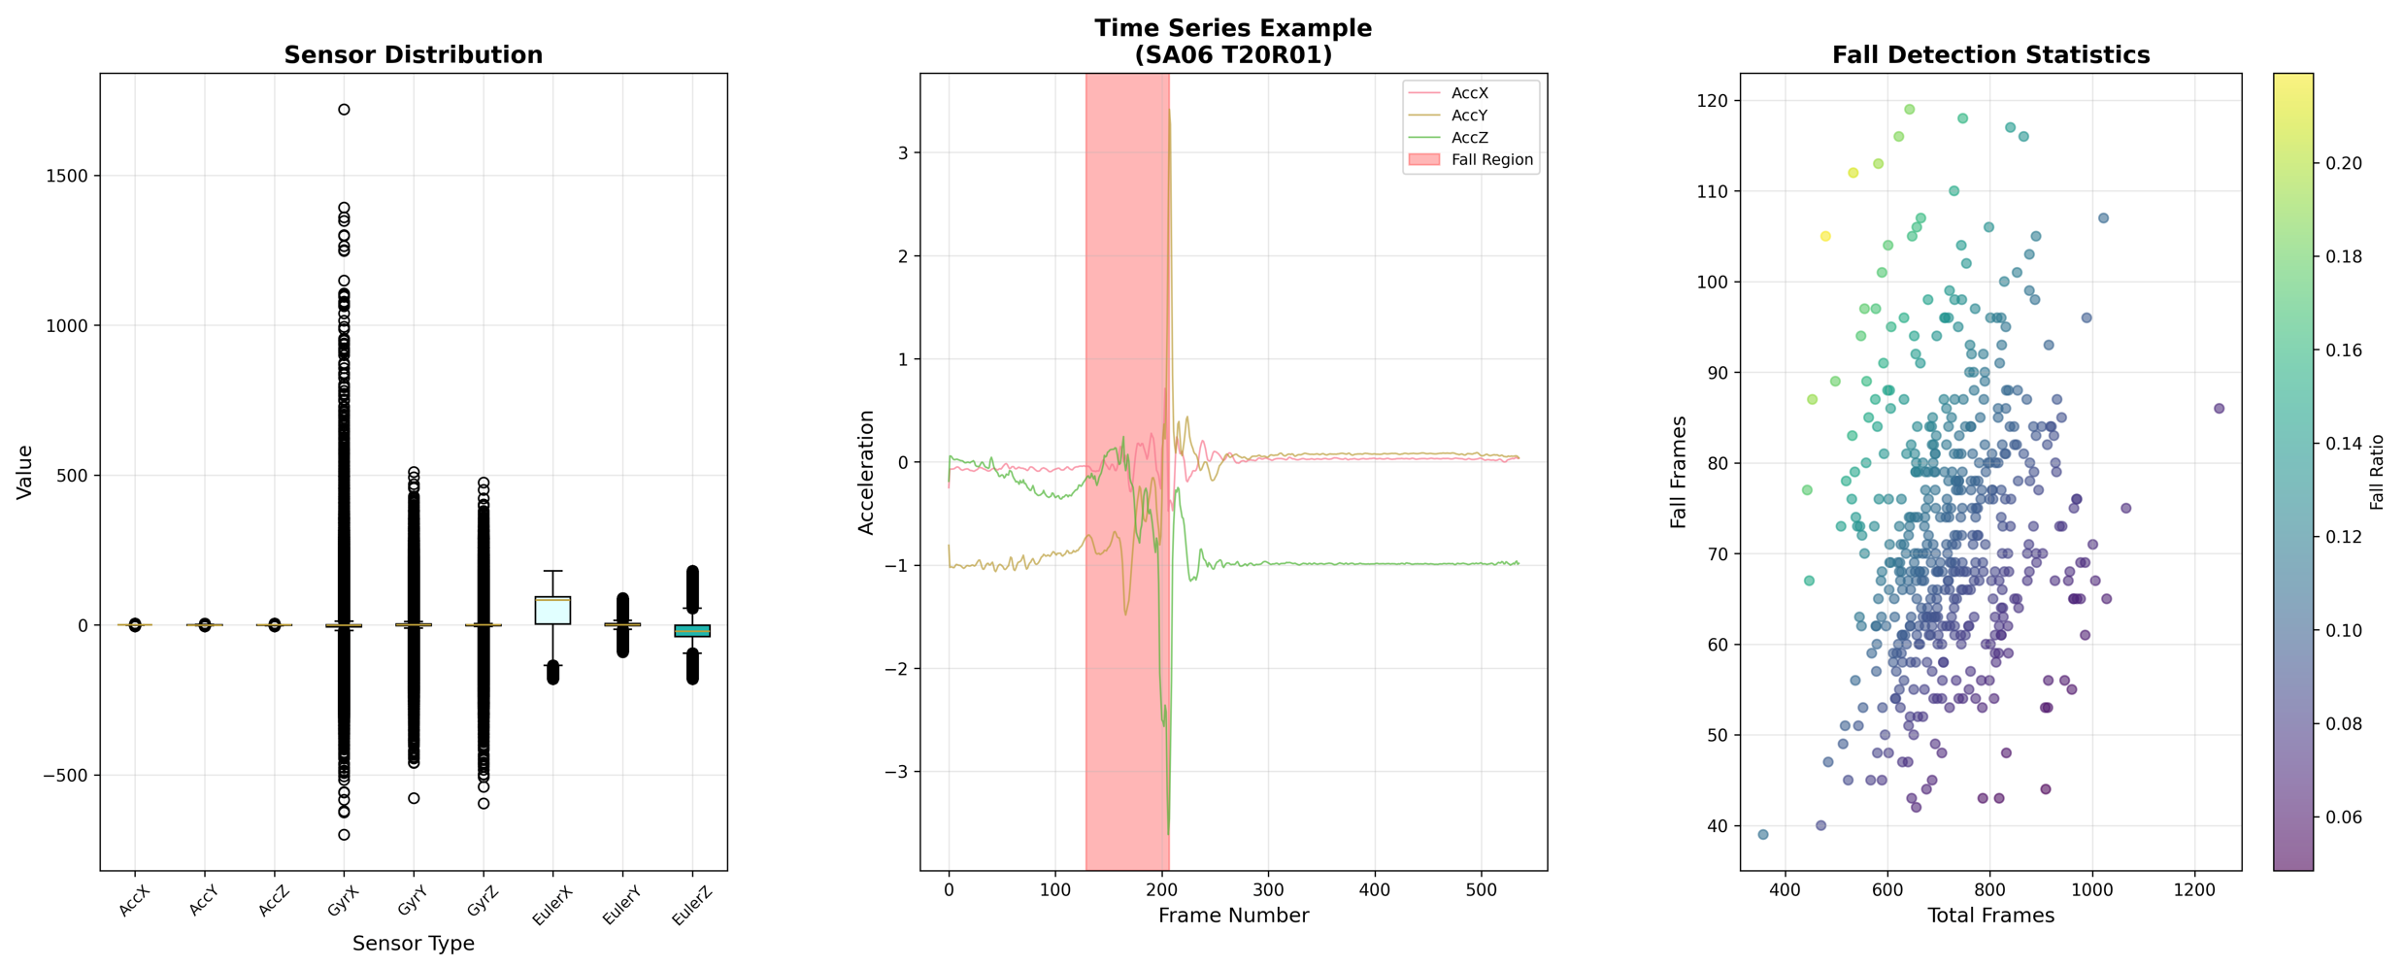
Data integration and visual analysis

Slide 5
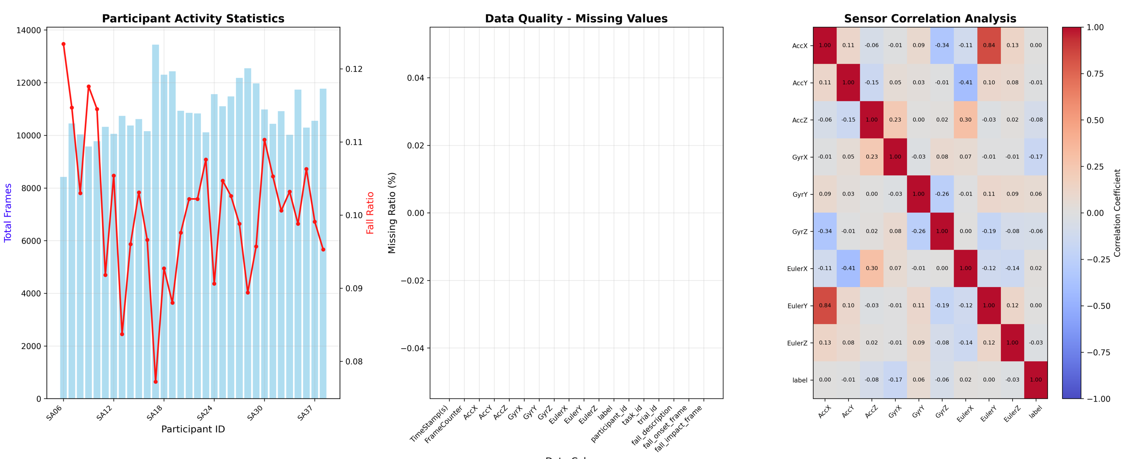
Data integration and visual analysis

Slide 6
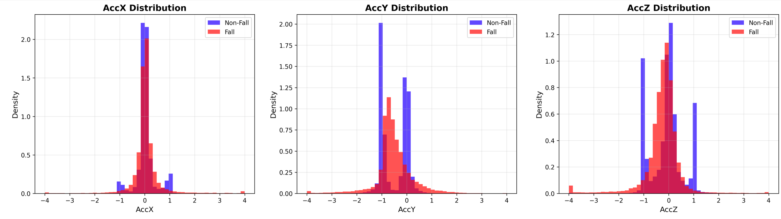
Data integration and visual analysis

Slide 7
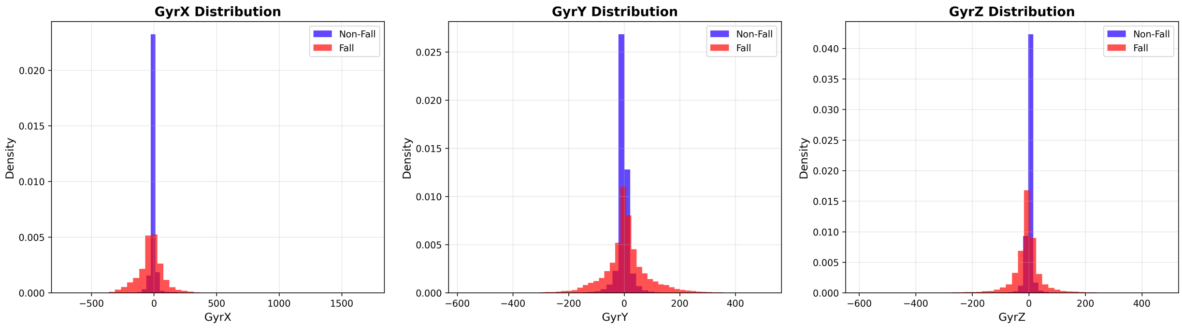
Data integration and visual analysis

Slide 8
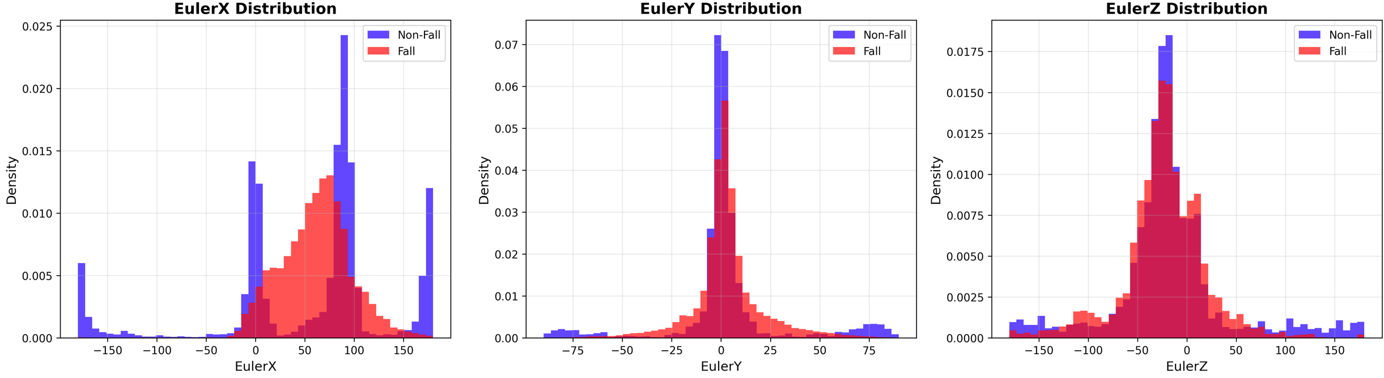
Data integration and visual analysis

Slide 9
SVM training without considering the time series
02

Slide 10
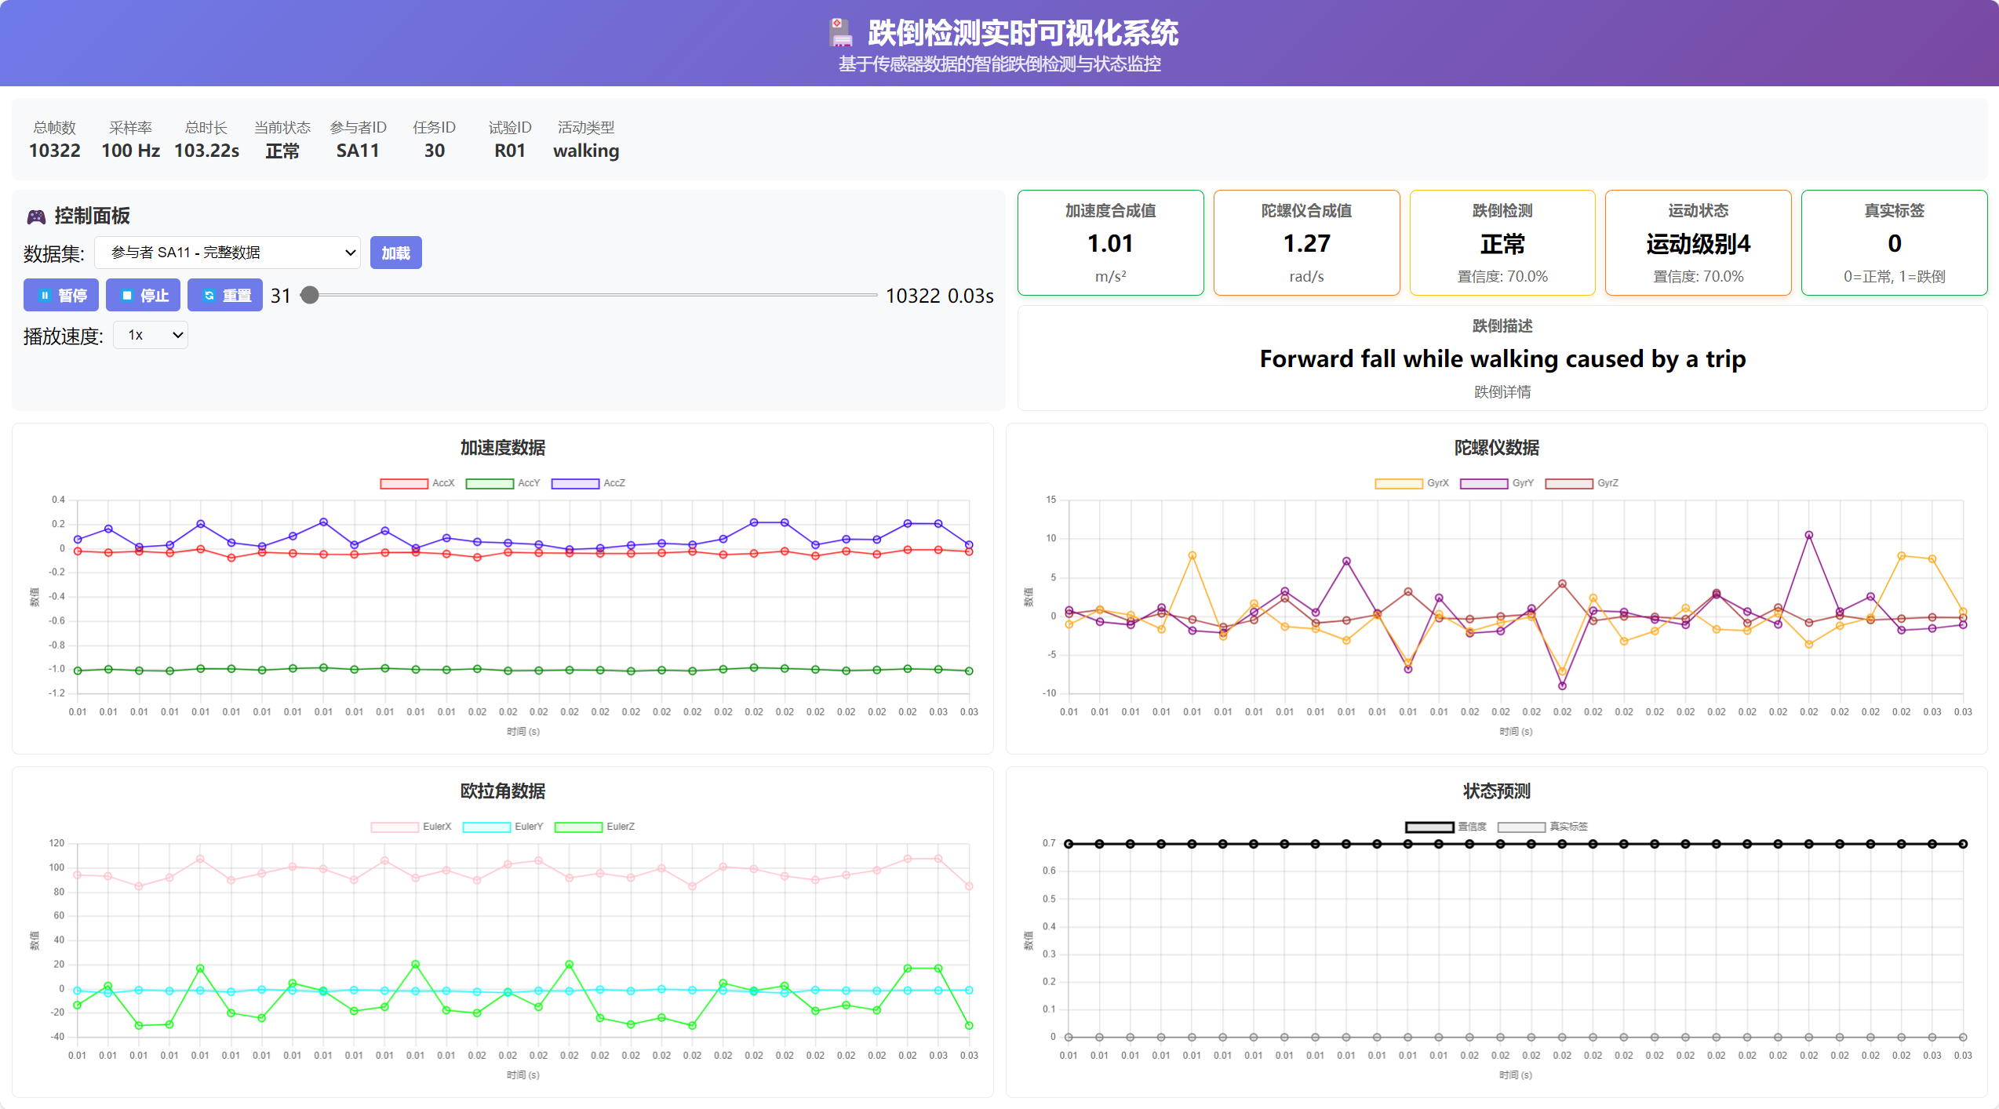
Only judge whether it is a fall state
We conducted the analysis using the self-designed web page and proved that all 9 parameters needed to be involved in the training, and the time series could not be ignored.

Slide 11
Train using LSTM and GRU
03

Slide 12
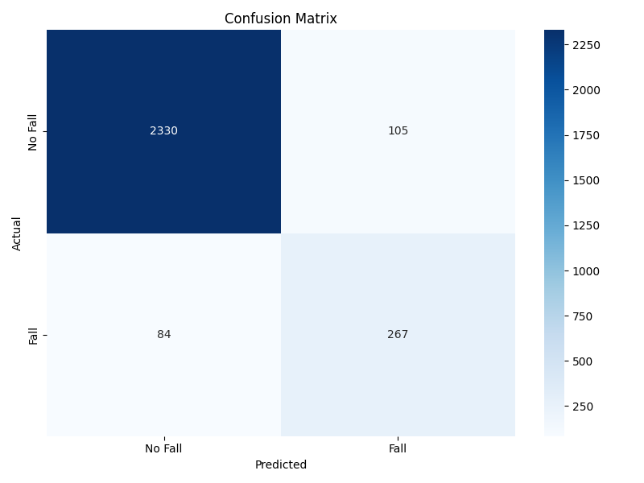

The original time series data was used without sampling

Slide 13
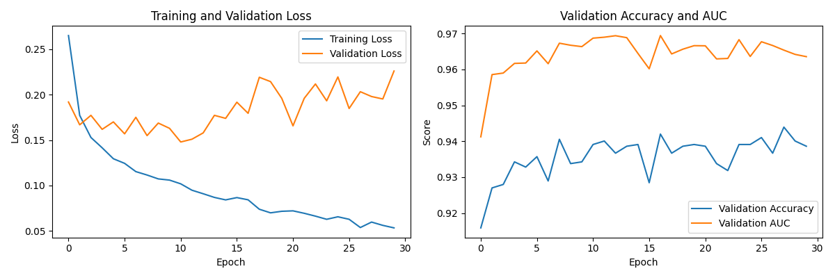
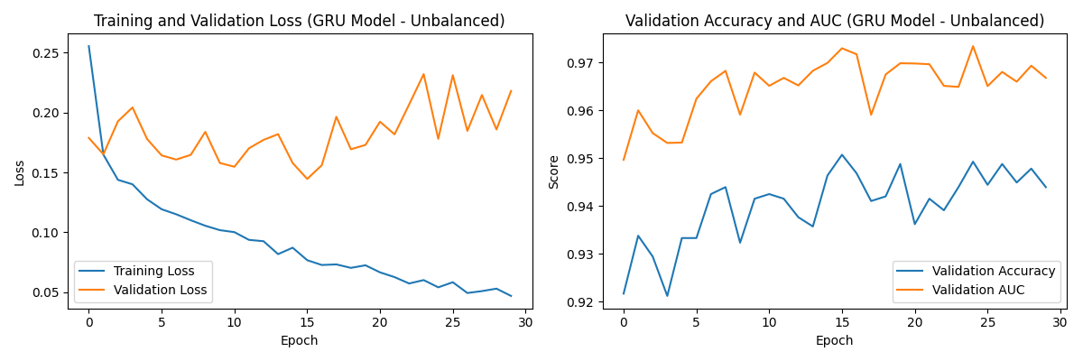
The original time series data was used without sampling

Slide 14
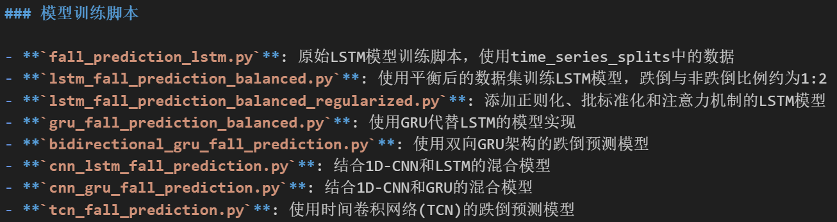
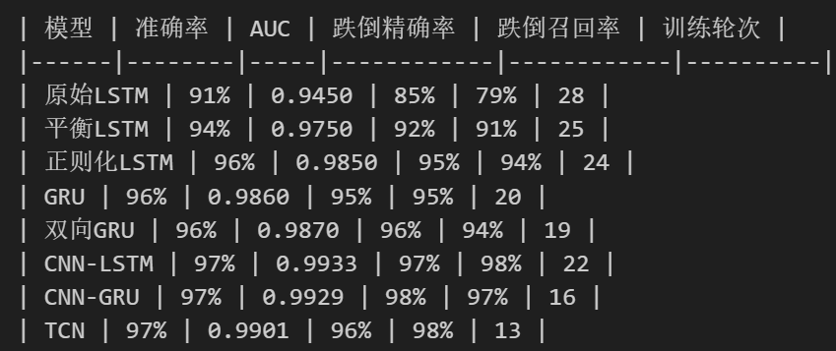
Train on the sampled dataset

Slide 15
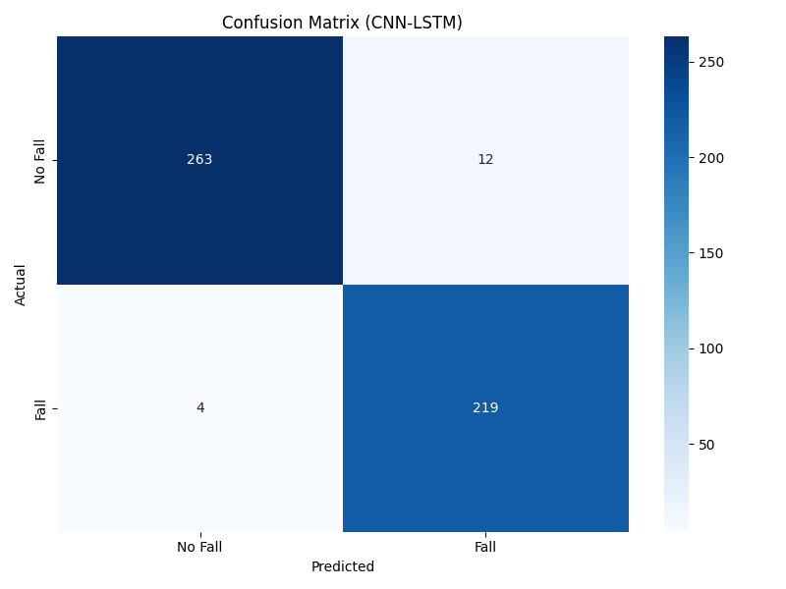
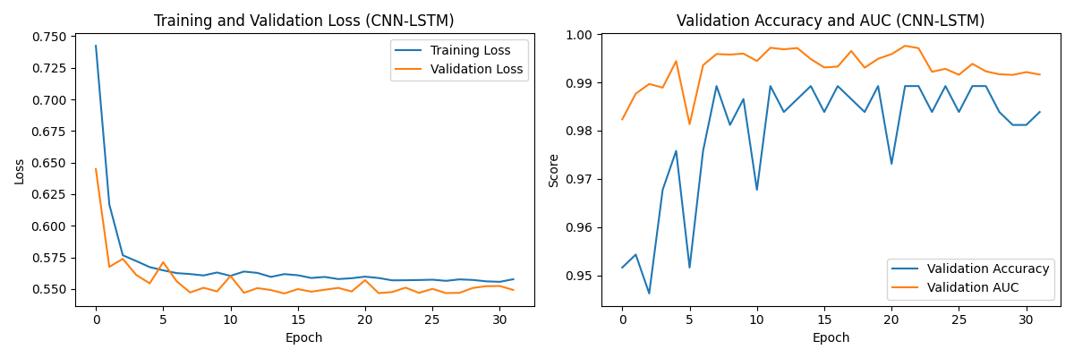
Train on the sampled dataset
This is the model that performs the best
CNN-LSTM

Slide 16
Actual test comparison and selection
04

Slide 17
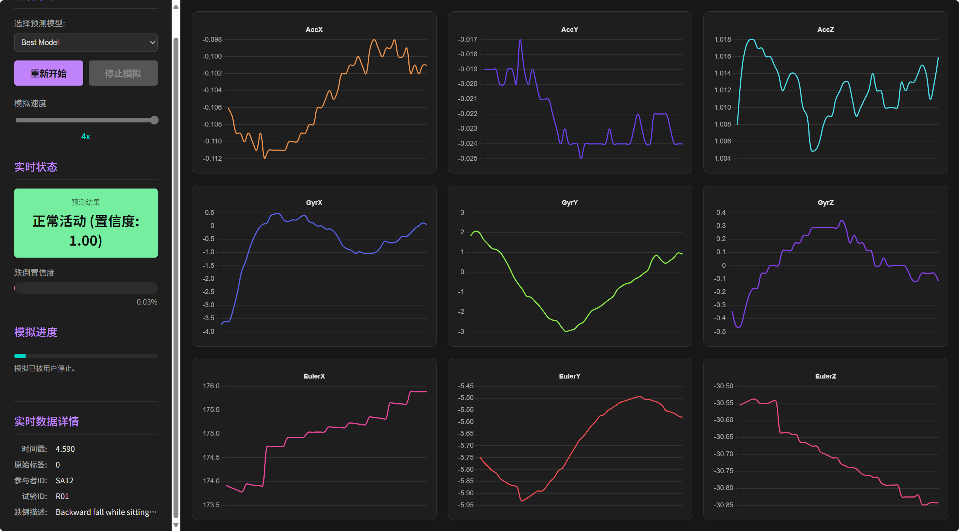
Actual performance of the model on the test set
We use a
self-developed web page for real-time model checking comparison
You can try it yourself using the packaged file or our open-source link in GitHub

Slide 18

Actual performance of the model on the test set
The reality is that a model trained on the sampled dataset will detect falls 1-2 seconds ahead of time
We chose to re-train the CNN-LSTM model using the unsampled dataset

Slide 19
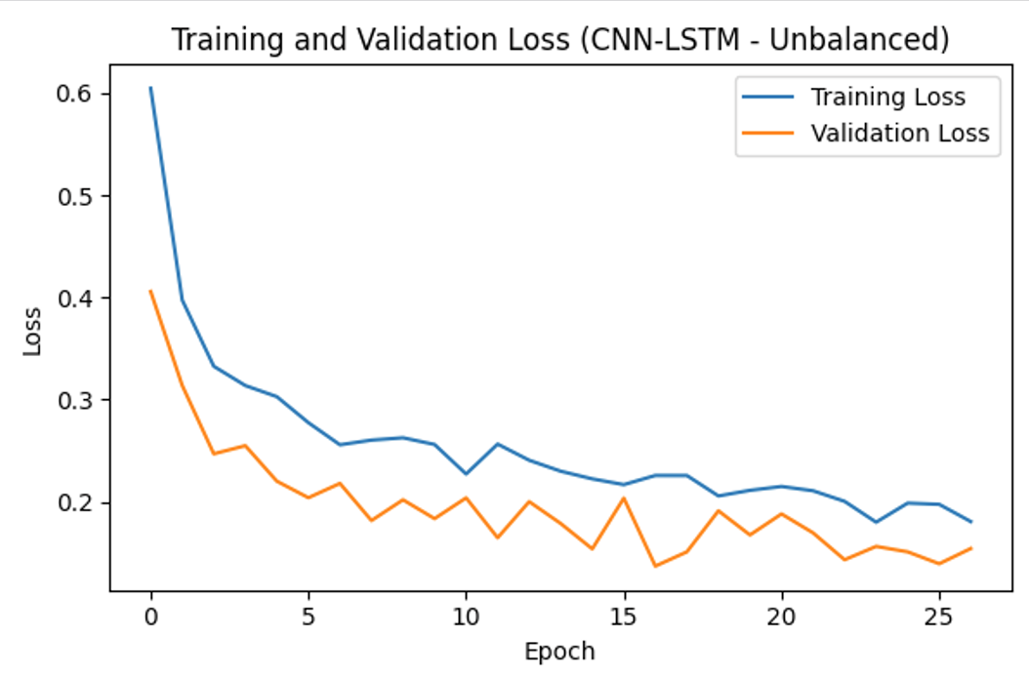
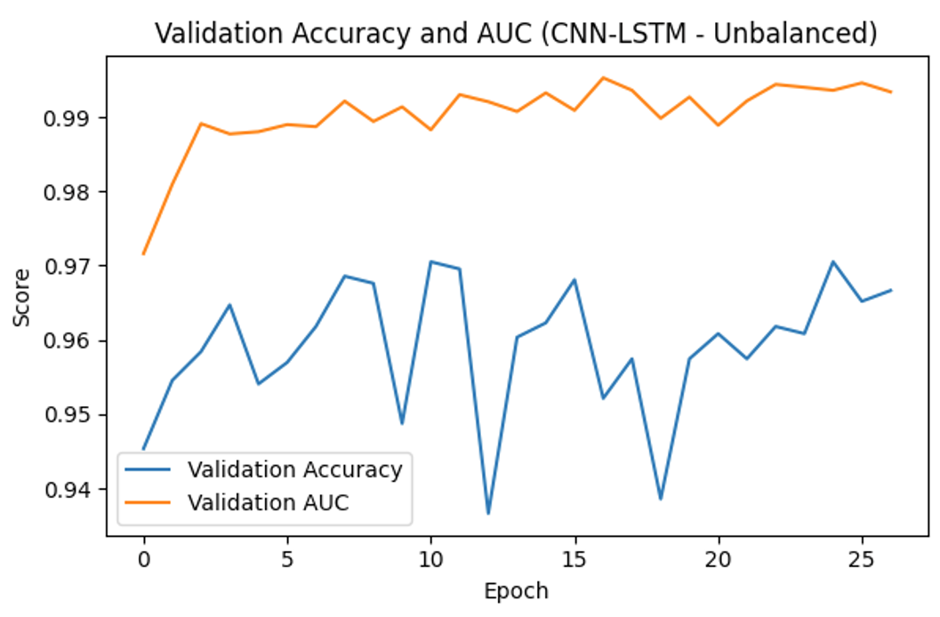
Actual performance of the model on the test set
The reality is that a model trained on the sampled dataset will detect falls 1-2 seconds ahead of time
We chose to re-train the CNN-LSTM model using the unsampled dataset

Slide 20
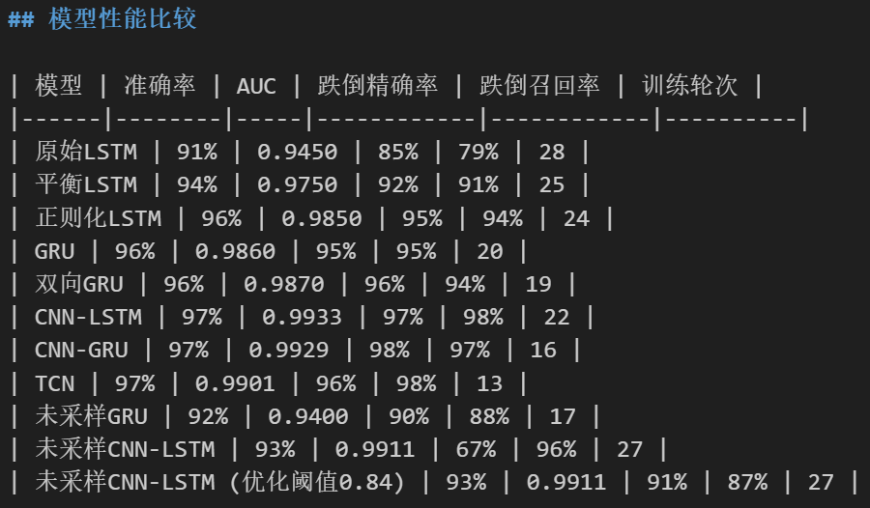
Actual performance of the model on the test set
Learning Rate Scheduler
The learning rate decay strategy is used to decrease the learning rate when the validation loss is no longer decreasing

Slide 21
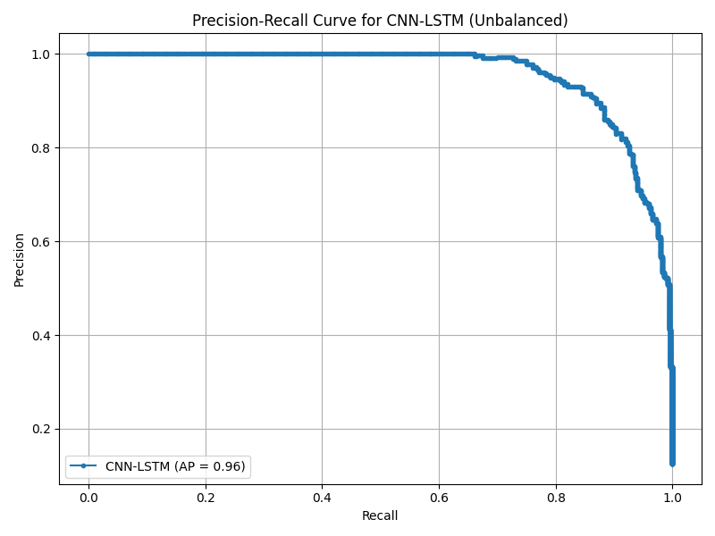
Actual performance of the model on the test set
The P-R curve is introduced to more comprehensively measure its precision and recall on the key category (falls)

Slide 22
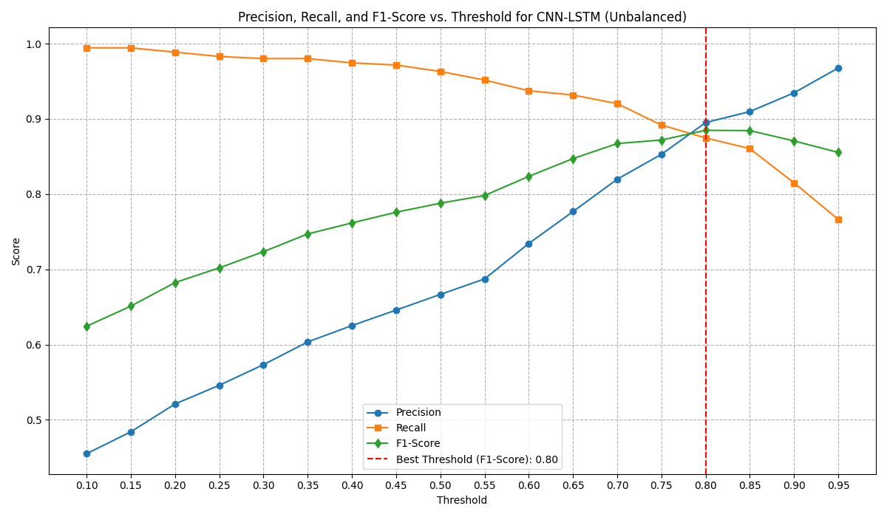
Actual performance of the model on the test set
Given that the original model suffers from "high recall and low precision" at the default threshold (0.5), we perform threshold optimization, aiming to find a more balanced performance point.

Slide 23
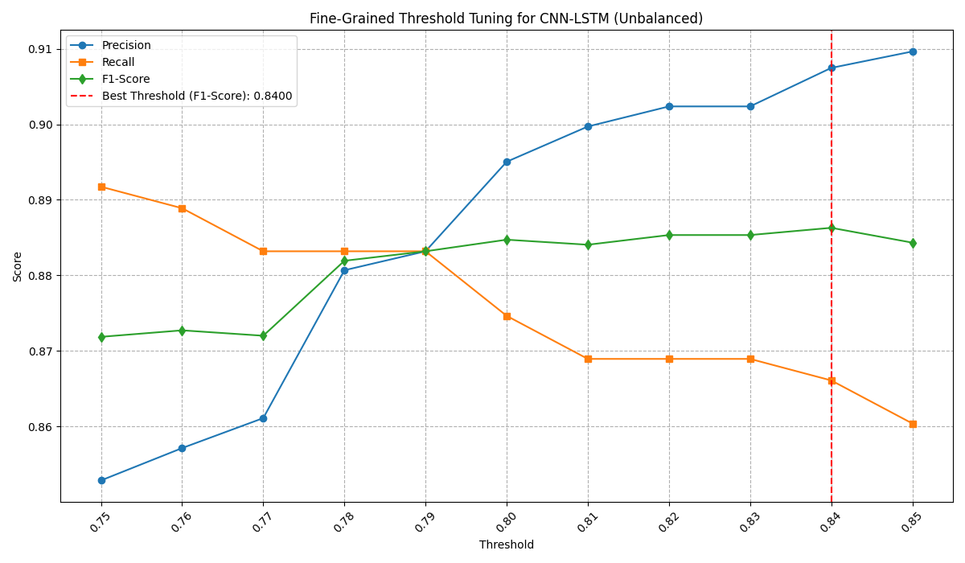
Actual performance of the model on the test set
To obtain a more precise optimal threshold, we further performed a refined search with a step size of 0.01 between 0.75 and 0.85.

Slide 24
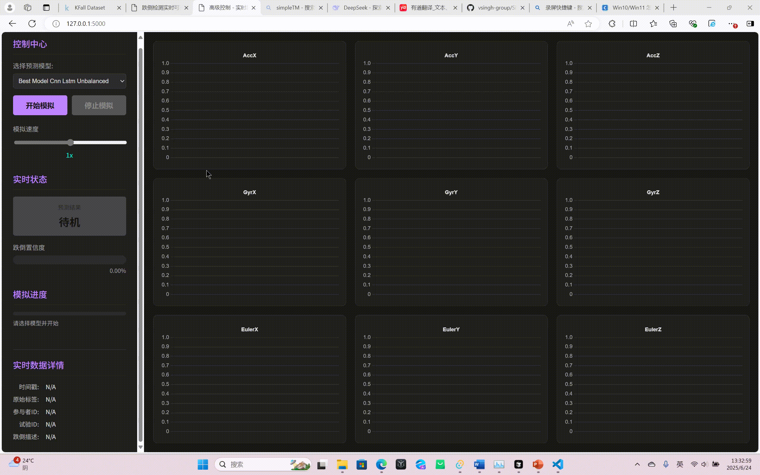
Actual performance of the model on the test set
The actual effect of the final optimized model on the test set.

Slide 25
Fusion uses one of the latest open source frameworks
05

Slide 26
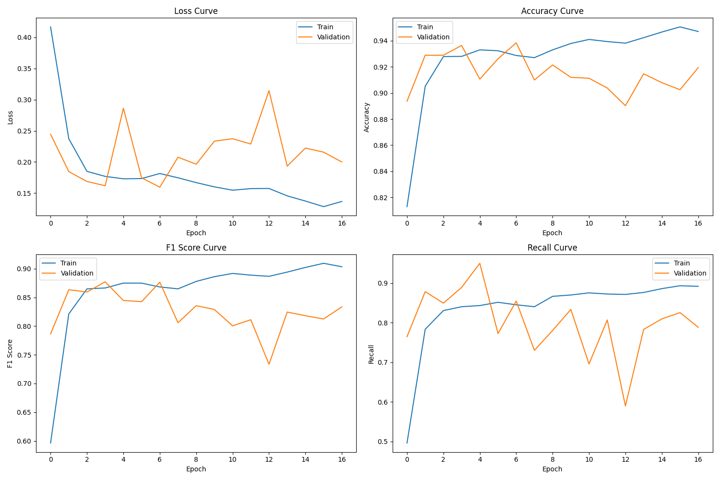
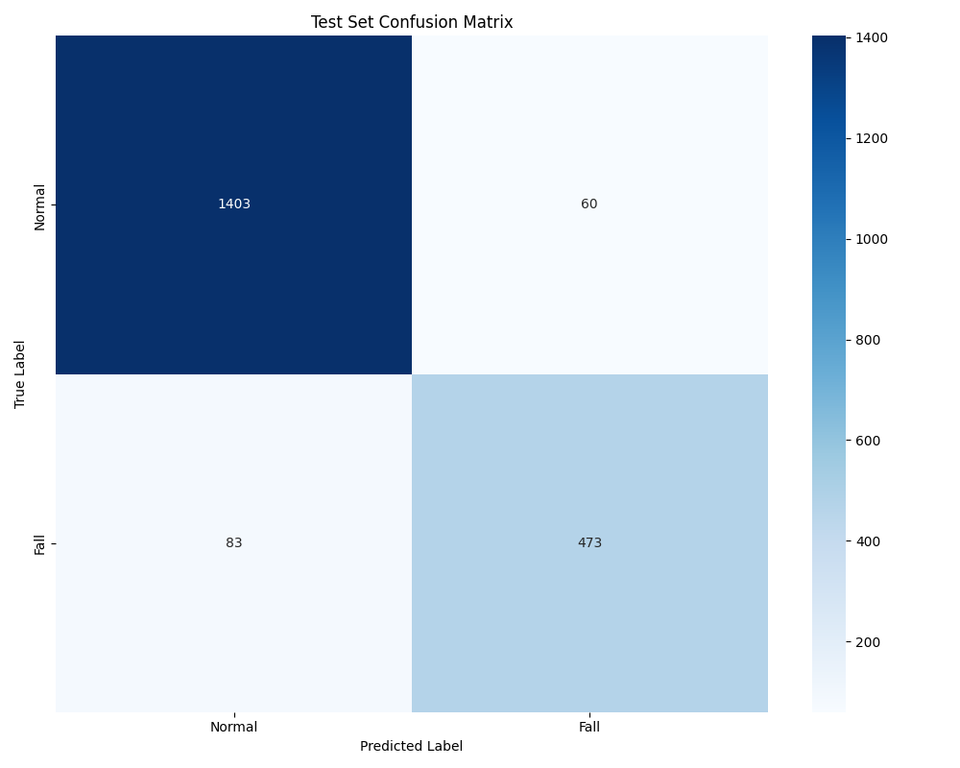
SimpleTM：Work with multivariate time series data
vsingh-group/SimpleTM: Official implementation for "SimpleTM: A Simple Baseline For Multivariate Time Series Forcasting" (ICLR 2025) (github.com)

Slide 27
Thanks and look forward to your correction
陈庭宇 230995210
刘泫含 230995210

